Slide 1
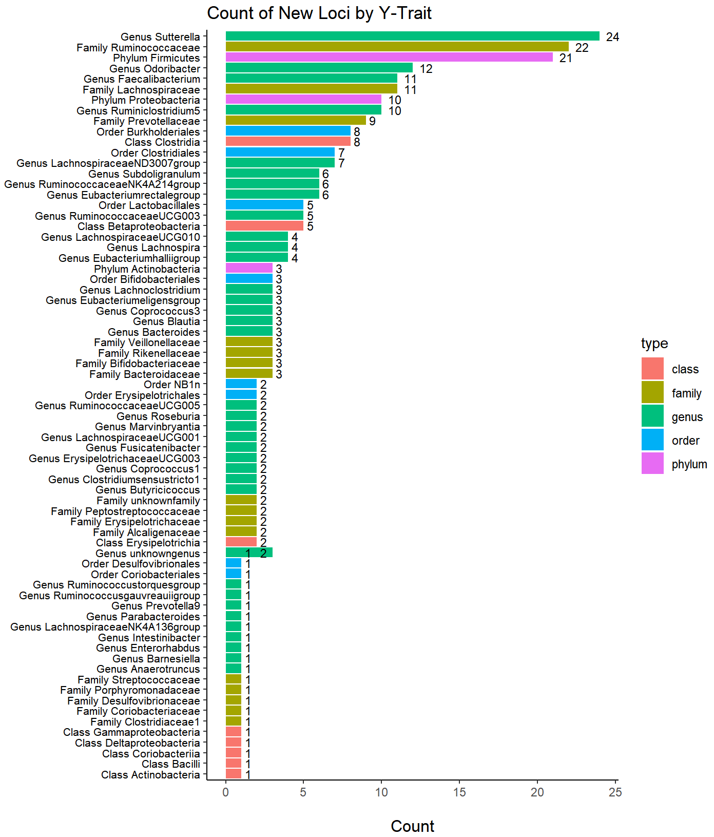
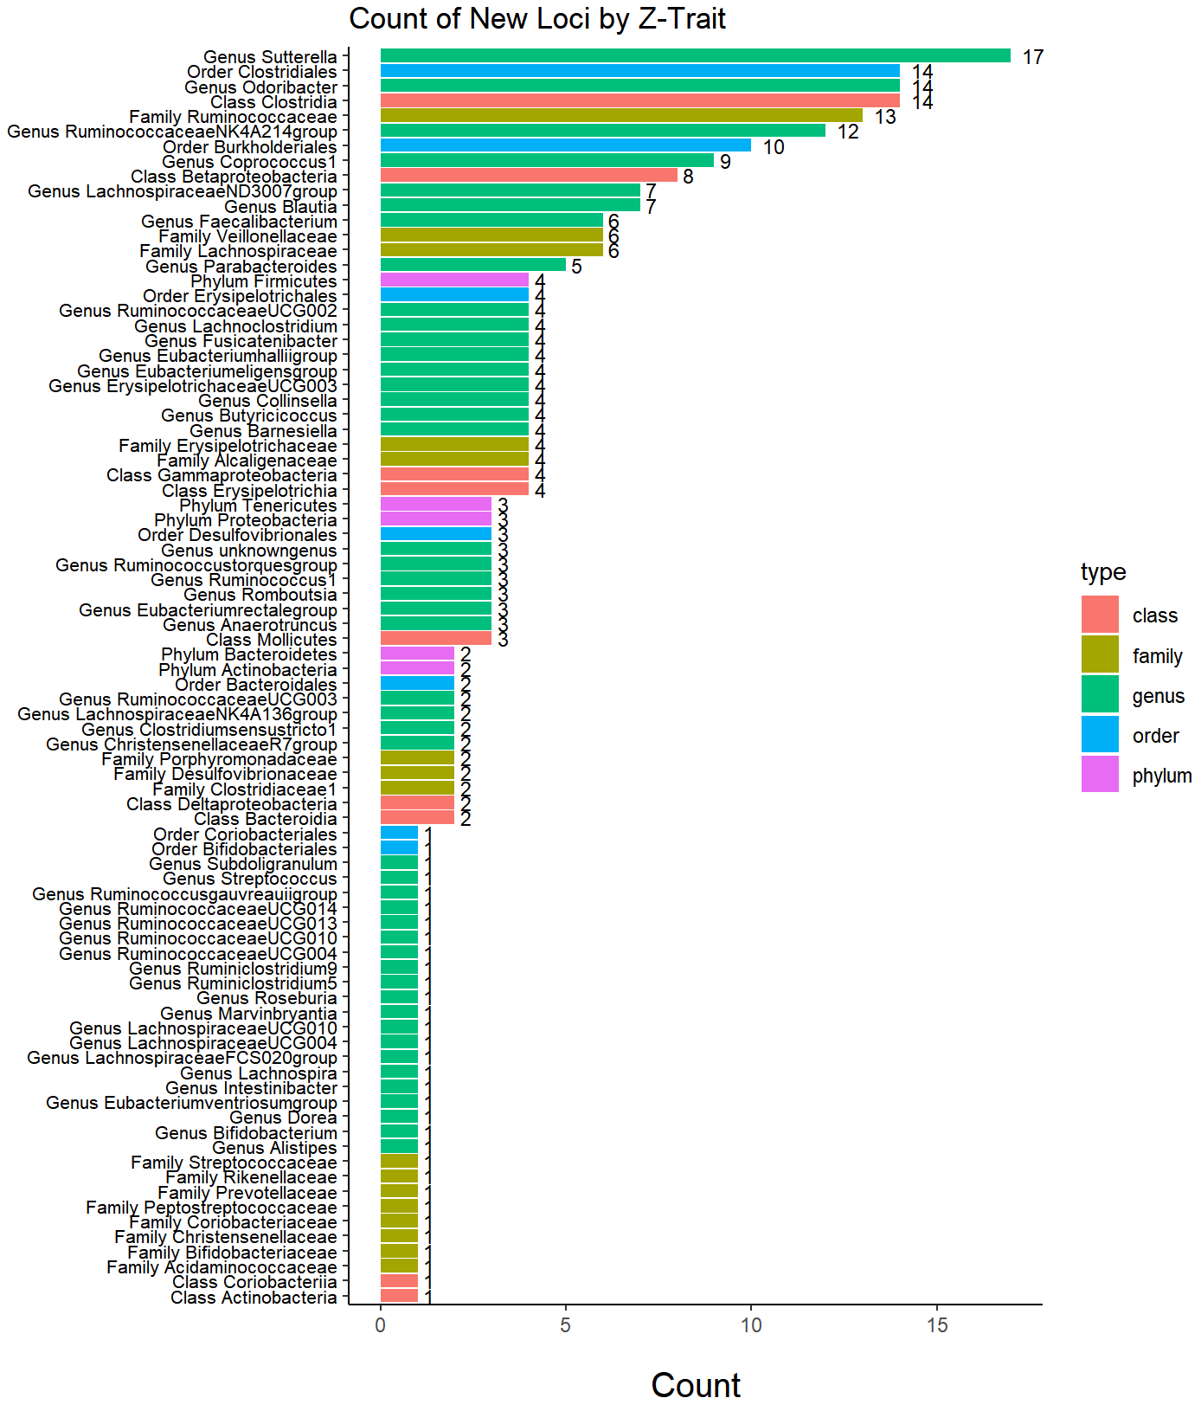
Suppl
Suppl Fig1 | Number of new loci identified by conditional GWAS across different gut microbial phenotypes.

Slide 2
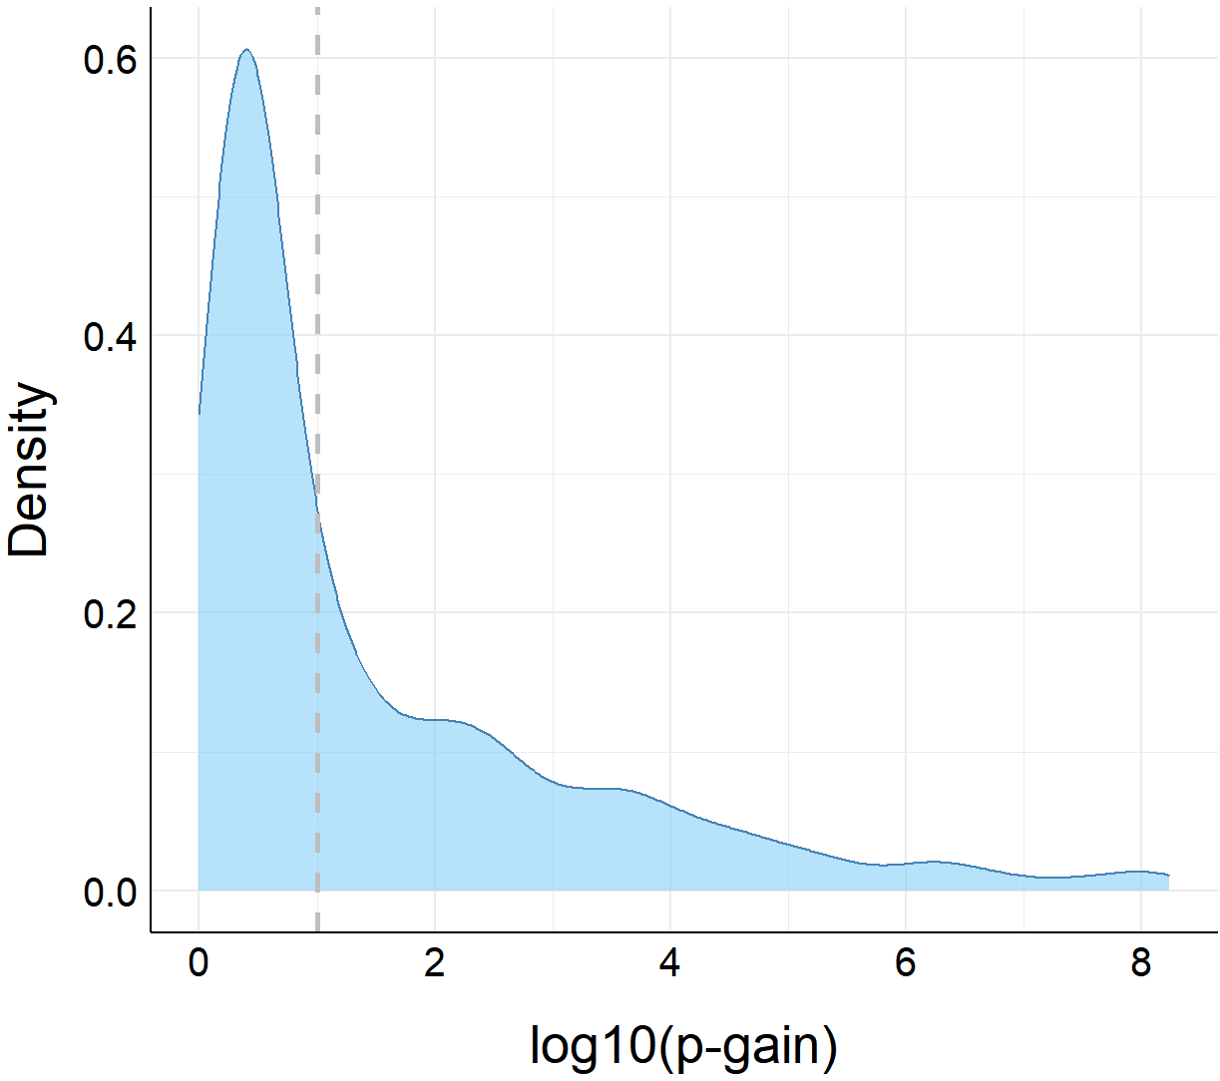
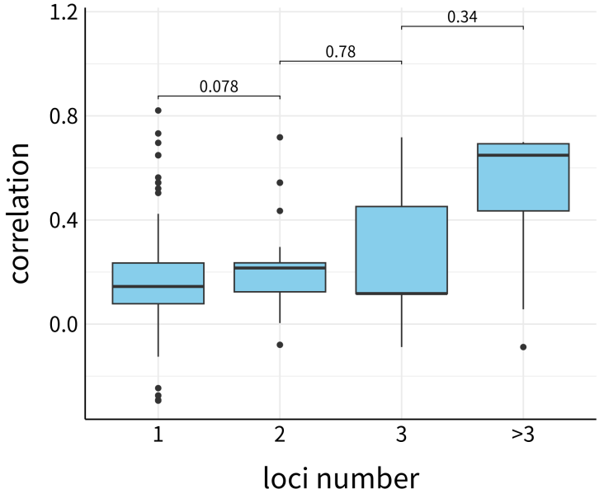
Suppl Fig
Fig2 | Distribution of P-gain of significant SNPs in new loci.
Fig3 | Realtionship between the phenotypic correlations and the number of new loci of each bacteria pairs.

Slide 3
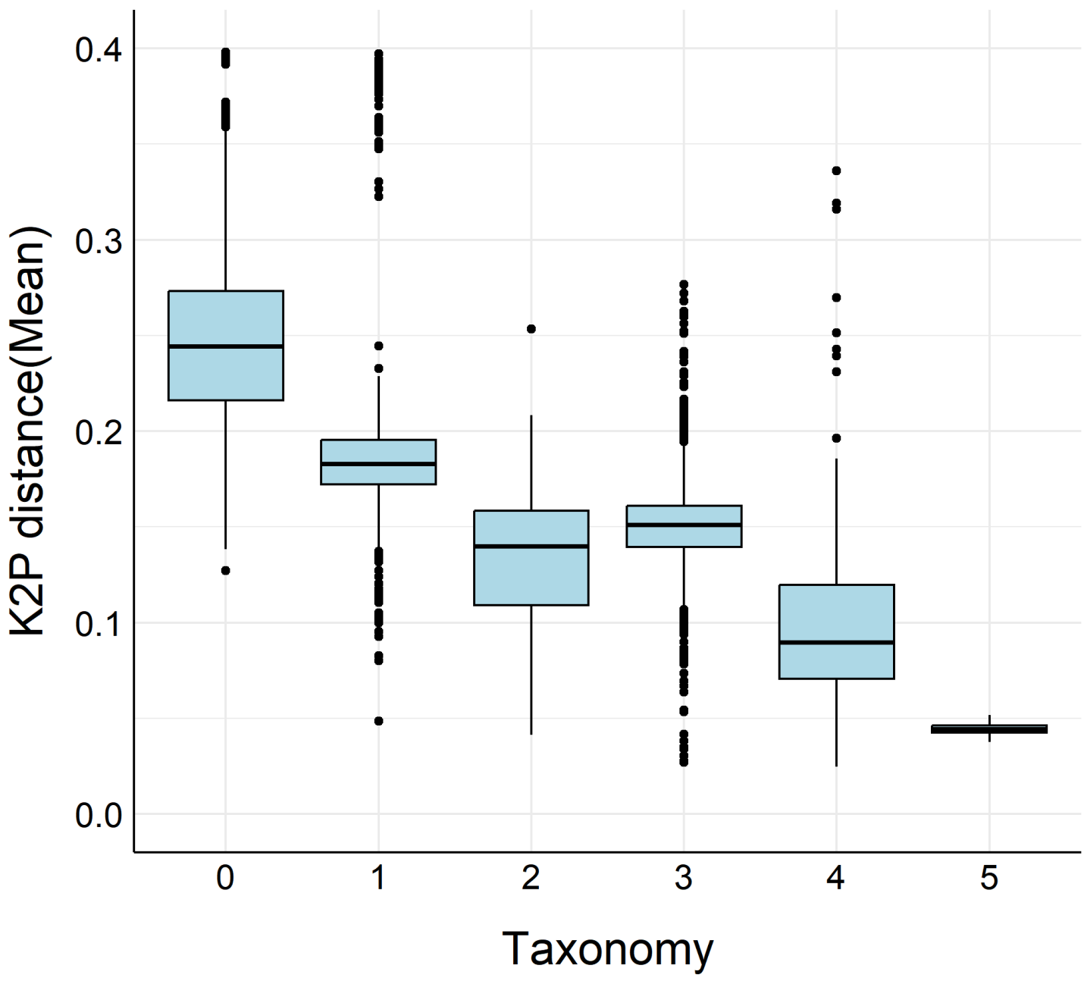
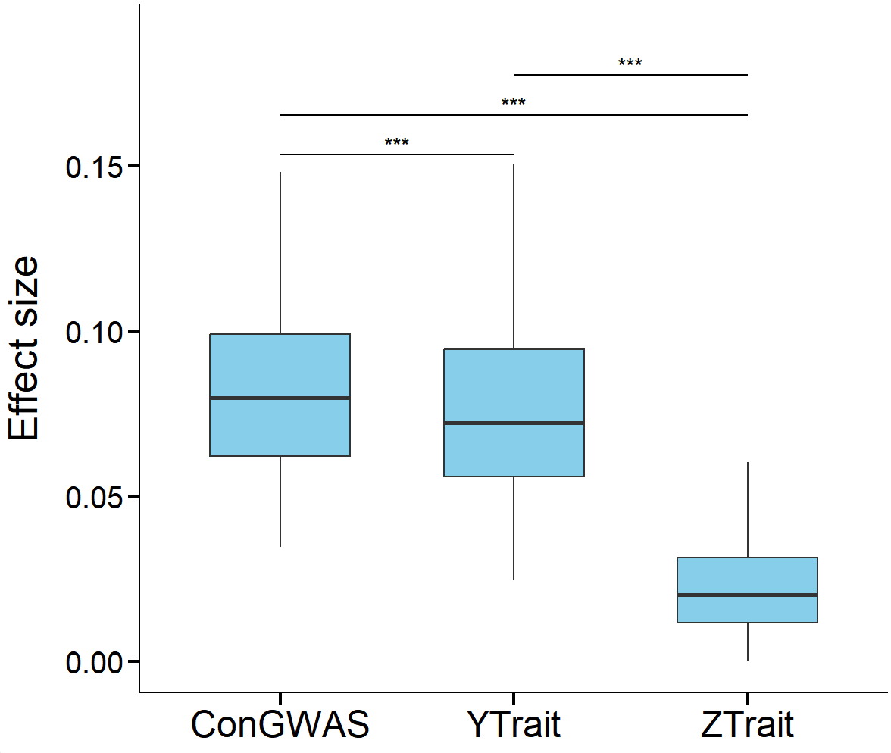
Suppl Fig
Fig5 | Realtionship between the K2P distance and taxonomic relatedness. Larger values on the x-axis indicate closer taxonomic relationships (e.g., a value of 5 denotes that two phenotypes belong to the same family).
Fig4 | Differences in absolute beta values of all significant SNP in new loci before and after conditional GWAS. ConGWAS: absolute beta values after conditional GWAS; Y Trait: absolute beta values in traditional GWAS of dependent phenotypes; Z Trait: absolute beta values in traditional GWAS of covariate phenotypes;

Slide 4
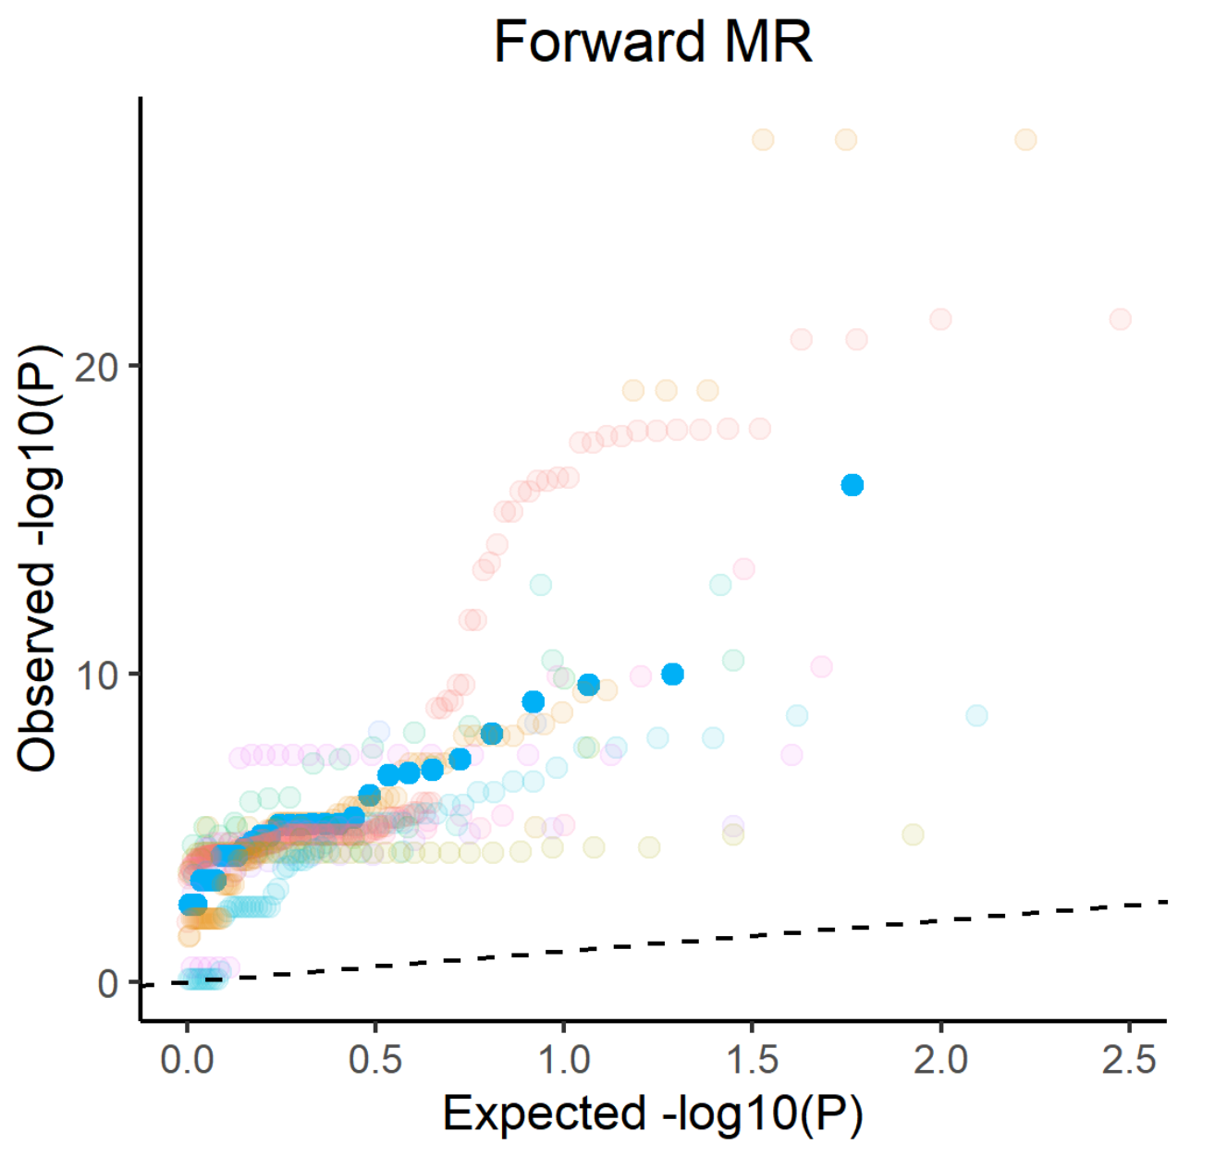
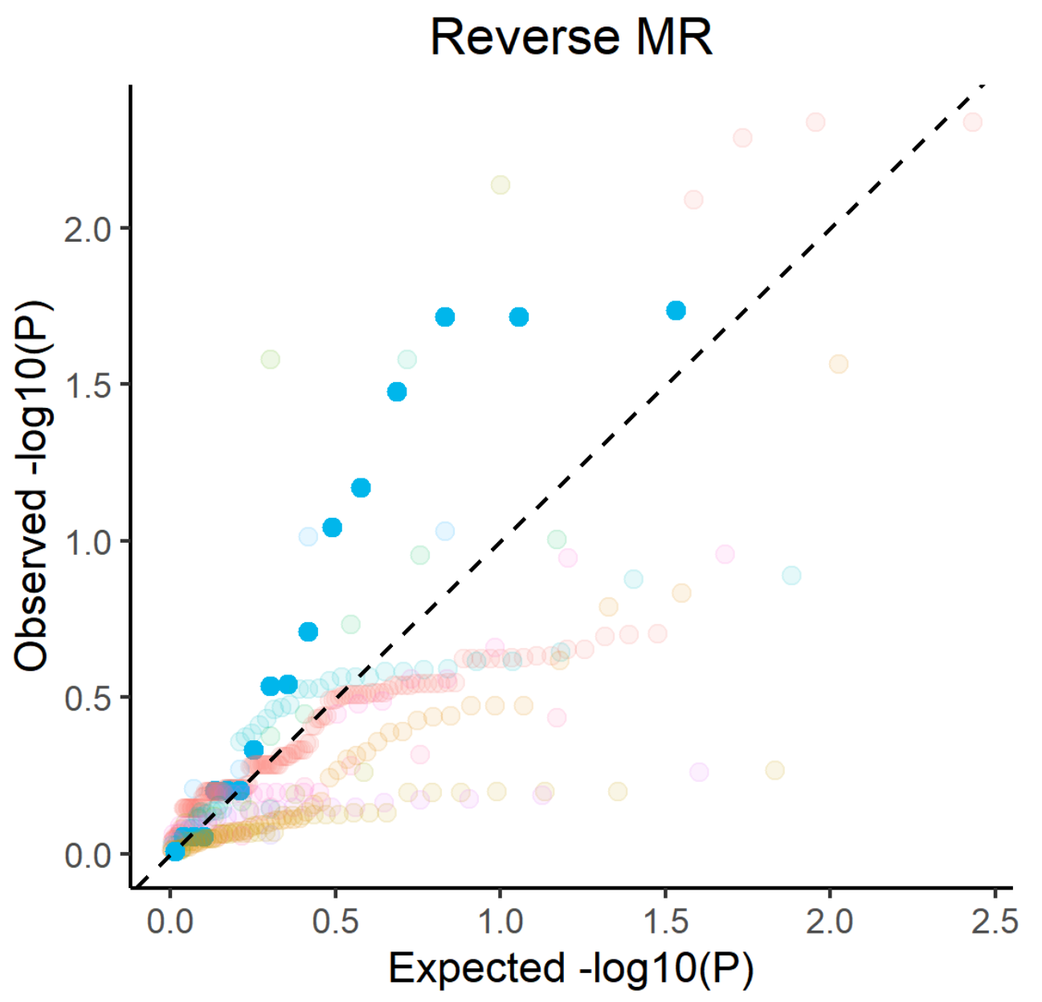
Suppl Fig
Fig. 6 | QQ plots of Mendelian randomization (MR) results of Medical conditions (self reported). Left panel show QQ plot of P-values from forward MR analyses, right panel show QQ plot of P-values from reverse MR analyses.

